Slide 1
Legacy to Modern
QT-HOL-3242LV
My VxRail Story
Richard Kenyan
Infrastructure Engineer – CUBRC
#vmwareexplore # QTHOL3242LV
Notes:
Standard welcome…
25 years in the industry
Worked in healthcare, finance, startups, fortune 50, small business
I’ve worked for a series of small companies that did big things, and a few big companies that did specific things.
vExpert / VMUG Leader
Don’t mention ops yet

Slide 2

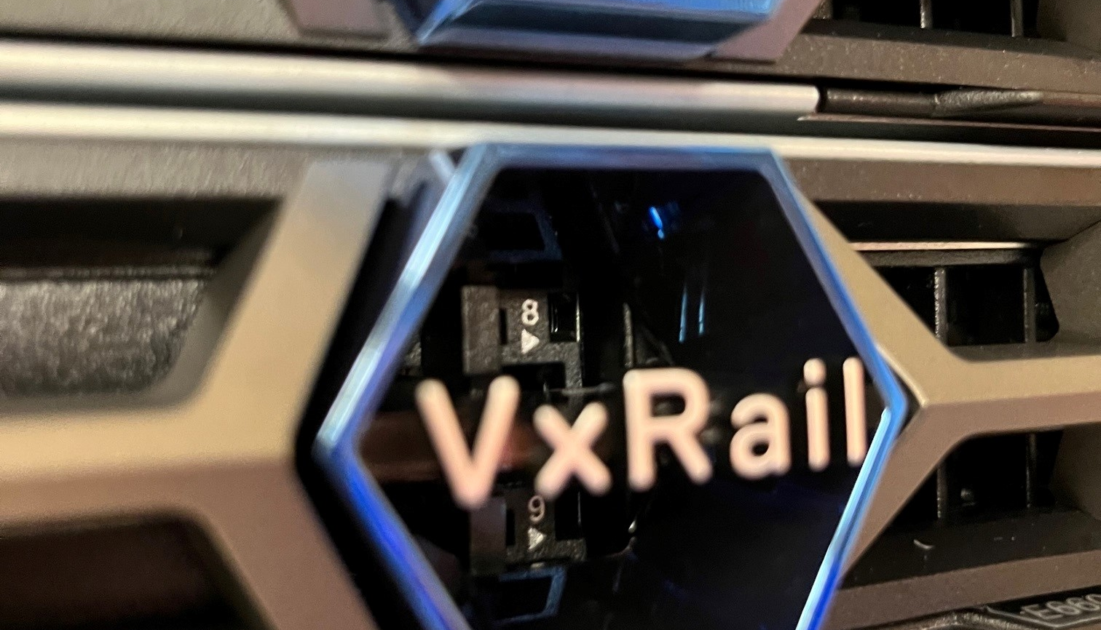

Customer Success – CUBRC
Budget, Flexibility, Scalability, FIPS/Encryption, Physical Space
ABOUT
SOLUTION
CUBRC is a leading Research, Development, Testing, and Systems Integration company specializing in these areas: Data Science & Information Fusion, Chemical, Biological, & Medical Sciences, and Aeronautics.
VxRail E660F nodes – x4 and x3 Dell S5248F-ON – x2 and x2 25Gbps networking 100TB vSAN Storage (ALL FLASH!) 370GHz CPU 4TB RAM
Buffalo, NY
Aerospace
CHALLENGES
IMPACT
Various storage solutions in play
3-Tier not ideal for lifecycle management
Forklift upgrades, disparate vendor hardware support contracts
Multiple infrastructure silos and management tools
Lacking NIST/CMMC FIPS 140-2
vSAN replaces separate SAN/NAS
Ease of day-to-day use
Collapse infrastructure (including networking), future expansion
One interface
NIST/CMMC FIPS 140-2
LEGACY PRODUCTS REPLACED
STRATEGIC PRIORITIES
EMC VNX5200
Customer / Vendor partnership
PowerEdge and R-Series Servers
Dell’s portfolio of solutions
Netgear Pro series networking
Feature flexibility for CUBRC’s needs (Tanzu)
Notes:
Make sure to mention 2 data centers
Make sure to mention Dell itself and what it brings to the table
Expansion is easy, just buy n nodes or increase your number of disks/memory.
BEFORE HITTING NEXT ON LAST SLIDE TEXT -> Introduce big reason: “MY BIGGEST REASON THOUGH?” CLICK

Slide 3
Biggest Reason?
TIME
Notes:
TIME / CVEs / Want to stay secure / obvious reasons

Slide 4
Time Spent
Every CVE represented the following process
Process
Research, HCL, Risk Assessment, Lab Deployment, Test, Wait, Confirm, Prod Deployment
CPU Intel/AMD Hypervisor vCenter VMware Tools
Networking NICs Firmware Drivers Physical Switches
Storage SAN/NAS HBA Drivers Firmware
LOM Firmware
HCL and research for each
Variables
GuestOS updates GuestOS perf. hits
Bug fixes Release Notes
Support Open internal tickets Open vendor tickets
Multiple vendors Finger-pointing RCA
Cross-vendor matrix Supported versions
Supply chains Hardware failures
Notes:
In my case, CVE patching is very important to me.
Mention previous operational work – Telecom/ISP – 9 Datacenters / 300 Hosts / 6000 VMs (5000 prod / 1000 dev)
I didn’t want to do that again, manually.
Dis-separate hardware, old legacy clusters, replacements on grey market, HCL past versions
Each box on this slide can be a separate talk on its own

Slide 5




Time Saved
A new, simpler update process
One Dell VxRail SKU – You are buying a solution, not a stack
Open Support Request
Dell Health Check
Dell Deploy Schedule
Dell Verifies Solution
One Call
One Product
One Solution
Notes:
VxRail is truly an all-in-one solution.
All release testing is done by Dell, resulting in thousands of hours already run on a /relatively/ limited set of hardware SKUs.
Am I still reading release notes? Sure. But just the VxRail/VMware ones.
Dell patches /CVE fixes/releases have reliable release patterns of 6-8 weeks, so any thing I’m hit by can be planned out beforehand.
MENTION -> MULTIPLE CVEs get patched as your entire solution gets patched…networking/storage/VMware/LOM
CALL DELL – you bought the solution, it comes with support. Don’t do it all yourself. You bought an HCI solution! Utilize the support teams, YOU PAID FOR IT.

Slide 6

Real-World Numbers
Sure, some marketing fluff, but I can corroborate.
Man Hours: Customers have reported that using VxRail has allowed them to grow without having to increase staff because of standardization provided by VxRail. 1
No, really. The VxRail system we deployed has drastically reduced the time I now spend on the care and feeding of my VMware Infrastructure.
Outages: 81% faster to resolve unplanned outages: The same IDC report found that customers who choose Dell VxRail can expect to resolve unplanned outages 81% faster. 2
Operations: 61% lower operational costs: The same IDC report found that customers who choose Dell VxRail can expect 61% lower operational costs. 3
ROI: 463% 5-Year ROI: According to an IDC report, customers who choose Dell VxRail can expect a 463% 5-Year ROI. 4
Notes:
Man Hours – 6 person IT Team – I’m senior/4 SMEs/1 Help Desk
Outage – 1 sort of outage so far – power off due to power circuit work – couldn’t boot up – 1 call to tech support – immediately knew all my info on about system, and what the error code was exactly. Walked me through easy HARDWARE procedure, everything came up. Saturday – at night…. – SAS CABLE DISCONNECTED – 1 hour to fix between call time, setup, fix, document, tear down ladder, power up, function restored.
Operations – once it was setup, I get CloudIQ reports daily
ROI – couldn’t beat the price – have started to use the platform in ways we hadn’t thought of – lower power usage

Slide 7
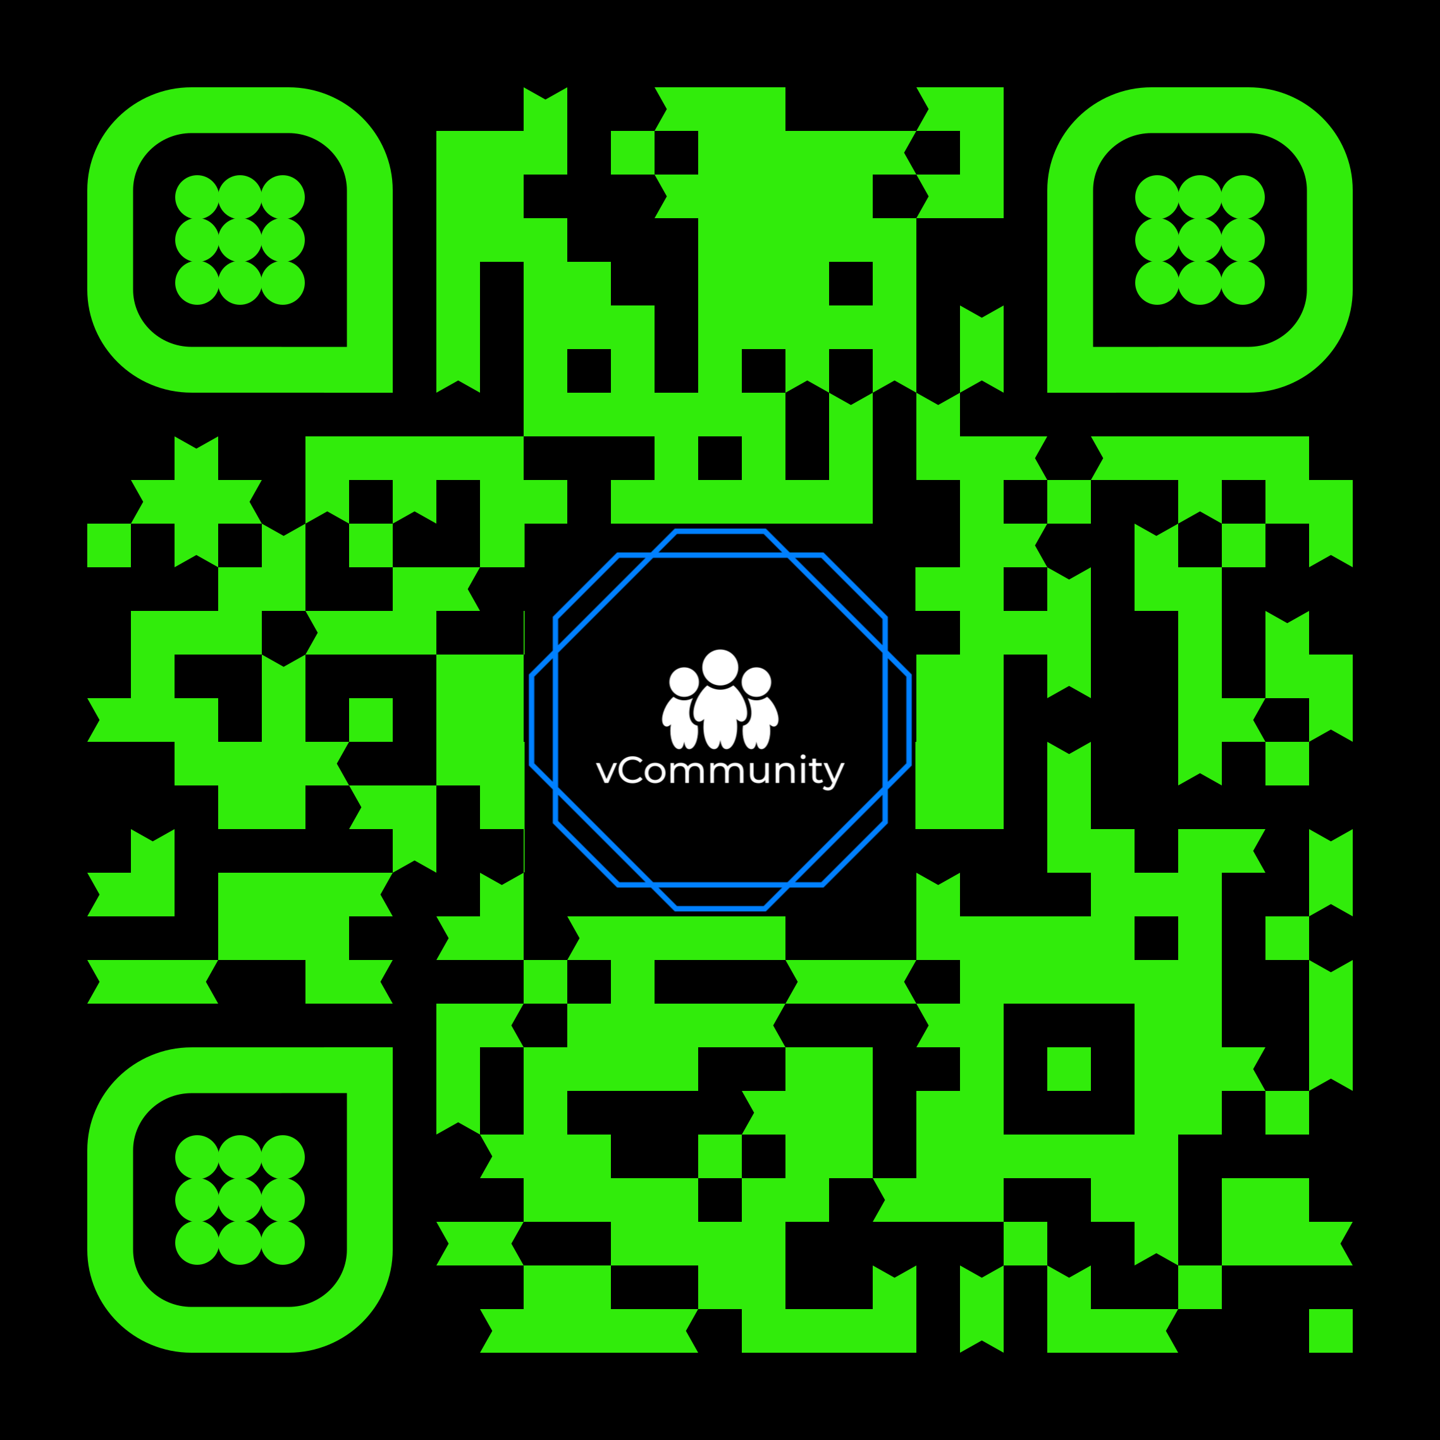
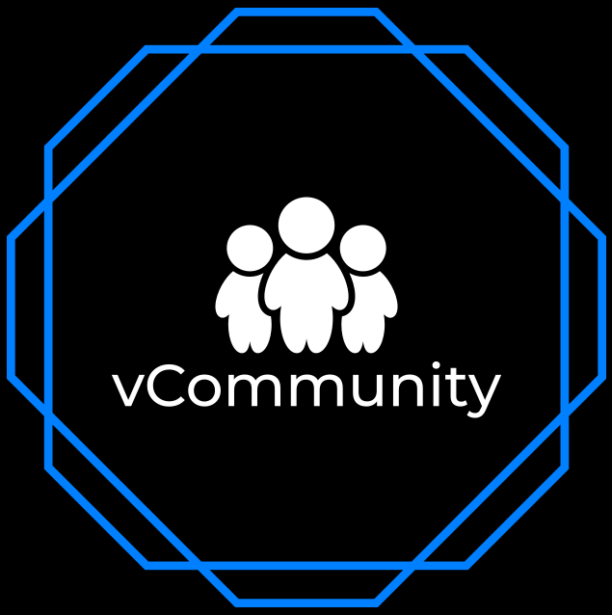
Stay Connected Let’s continue the conversation
Follow @VxRail, #VxRail, @DellStorage_HCI, @RichardKenyan, @ITRealityUS
Dig deeper: Join our vCommunity Discord
Notes:
Multiple topics in our discord
All things VMware and more
Industry rooms for security/backups/storage/etc…

Slide 8
Please take your survey.

Slide 9
Thank You

